Slide 1

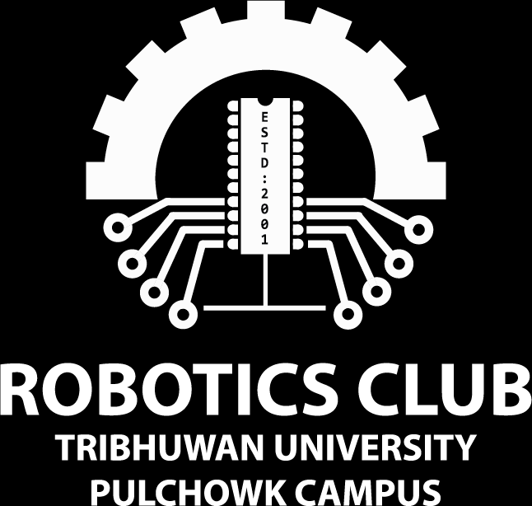

Workshop on
Basics of Hardware
Day 5: PWM and DC Motors

Slide 2
What will we learn today?
LM78XX, LM7805, LM7809
Use of capacitors
Servo Motor and Its interfacing
DC motor: Speed Control(PWM)

Slide 3
Let’s Get Started!!
Shall We?

Slide 4
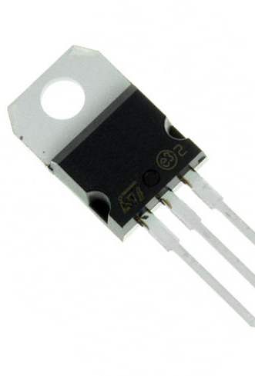
LM78XX Series
3-terminal Linear regulators.
Used extensively in the device that needs the regulated power supplies such as microcontroller.
'XX' indicates the voltage that each regulator outputs.

Slide 5
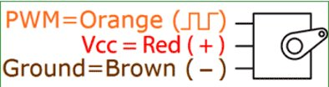
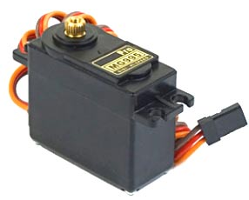
Servo Motor
A servomotor is a rotatory actuator or linear actuator that allows for precise control of angular or linear position, velocity and acceleration.

Slide 6
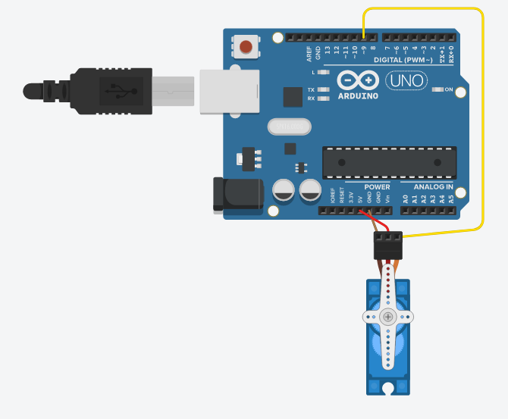
Servo motor interfacing with arduino
#include<Servo.h>
Servo servo;
int angle;
void setup()
{
servo.attach(9);
}
void loop()
{
for (angle=0; angle<=180; angle += 5){
servo.write(angle);
delay(100);
}
for (angle=180; angle>=0; angle -=5) {
servo.write(angle);
delay(100);
}
delay(2000);
}

Slide 7
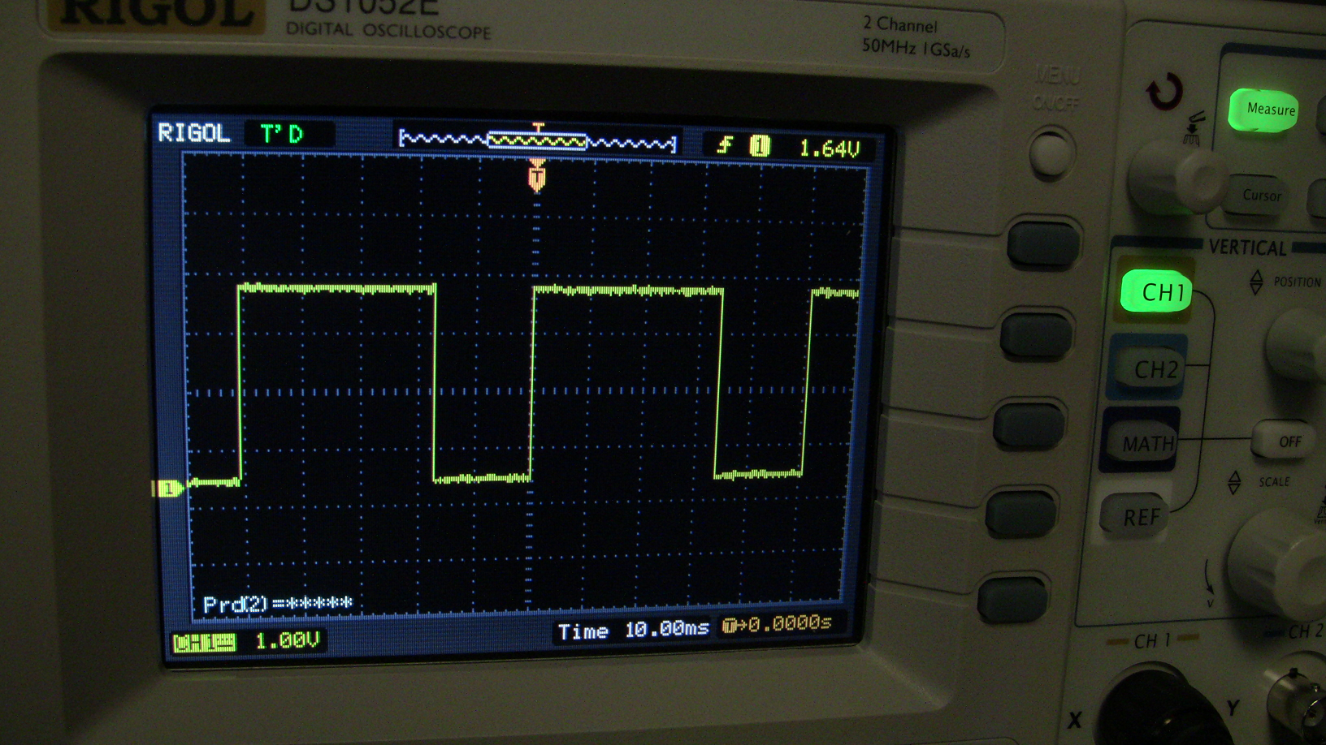
PWM (Pulse Width Modulation)

Slide 8


What basically do you understand by Pulse?
Electronic Pulse is nothing but a graphical representation of the nature of the flow of current in an electrical or electronic circuit.
Simply, it is a pulse is a burst of current, voltage or electromagnetic-field energy.
Digital pulses usually have well-defined shapes (like square and triangular) which can be easily observed in an oscilloscope.

Slide 9
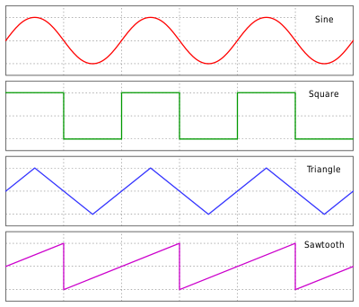
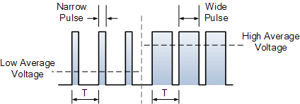
Different Types of Pulses

Slide 10
What do you mean by PWM?
Pulse width modulation (PWM) provides a way of controlling certain analog quantities, by varying the pulse width of a fixed frequency having waveform.
Pulse Width Modulation (PWM) uses digital signals varying is usage from normal communication to the control power applications.
So, what are the factors that impact on the PWM's behavior :
Duty cycle.
Frequency of a PWM signal.

Slide 11
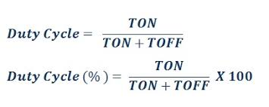
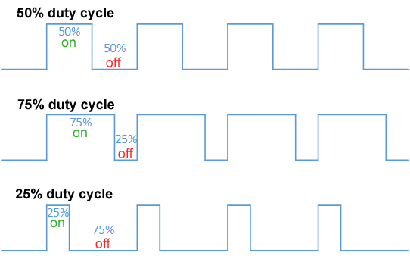
Duty Cycle in PWM
It is commonly expressed as a percentage or a ratio.
Duty cycle of 50% means pulse is high about half of its total time period.
So, what does 100% duty cycle means?

Slide 12
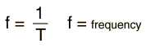
Frequency of PWM signal
A period is equal to the time this signal completes a one-and-off cycle.

Slide 13
Applications of PWM:
It is used to control the speed of the motors in Industries.
It is used for dimming of the light.
It is used in communication system(encoding of messages).
It is used in audio system like making buzzer with different loudness.
Using the PWM technique and the switching mechanism we can control analog signals using the digital signal

Slide 14

Disadvantages of PWM:
As the PWM frequency is high, switching losses is considerably high.
It induces Radio Frequency Interference (RFI).

Slide 15
Implementing PWM with Arduino
PWM can be implemented in various ways on Arduino.
PWM output can be generated by specific pins in the uno R3 board (i.e. pin 3, 5, 6, 9, 10, 11 ) .
With analogWrite() function,calling the AnalogWrite() function allows a stable square wave with a specified duty cycle to be generated on the PWM pins.

Slide 16
The frequency of PWM signal on pins 5 and 6 will be about 980Hz and on other pins will be 490Hz.
The output voltage from Arduino pins are 5V, and different duty cycles output different voltage levels as seen in the table.
Duty Cycle ​ | Output Voltage Levels​
0%​ | 0V​
25%​ | 1.25V​
50%​ | 2.5V​
75%​ | 3.75V​
100%​ | 5V​

Slide 17

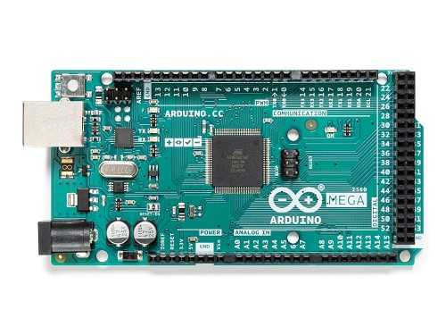
The PWM pins are labeled with ~ (tide) sign.

Slide 18

analogWrite()
Syntax:
analogWrite(pin, value)
Here, pin represents the pwm pin number in the microcontroller.
Value is the value ranging from 0 to 255.
It writes an analog value (PWM wave) to a pin.

Slide 19
analogWrite(pin,0-255) VS digitalWrite(pin,LOW-HIGH)

Slide 20
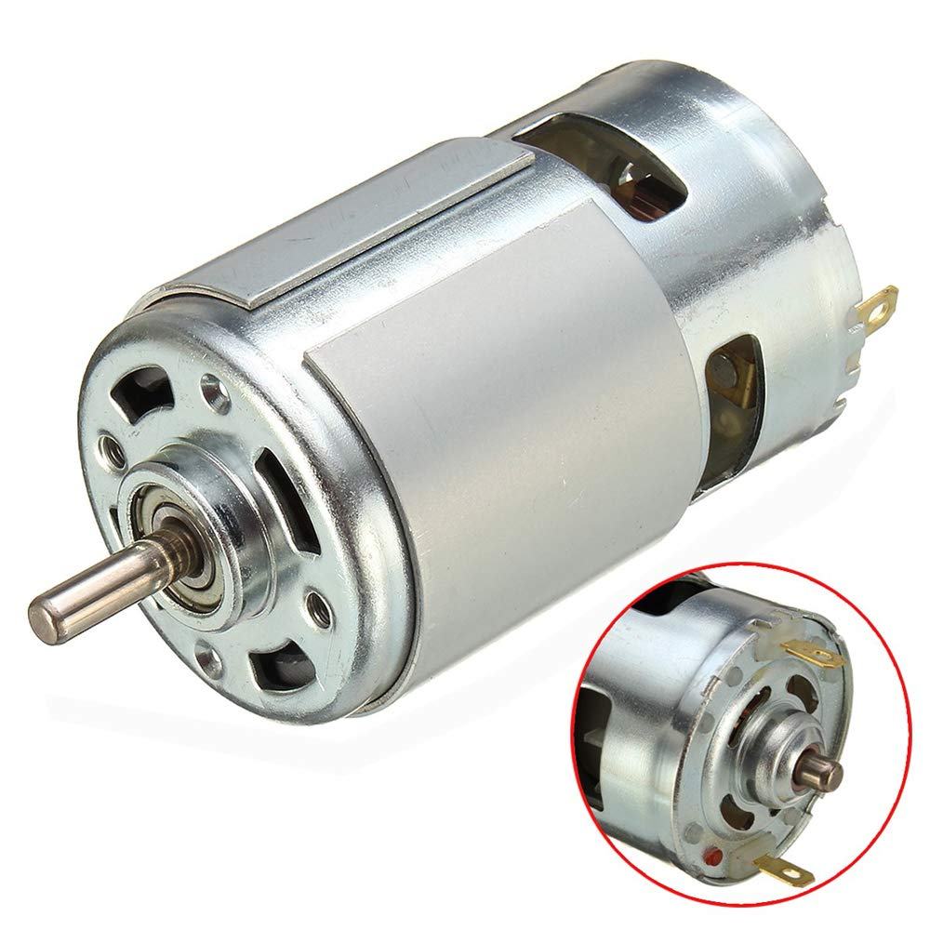
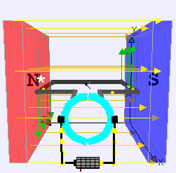
DC MOTOR
A rotatory electrical motor that converts direct current(DC) electrical energy into mechanical energy.

Slide 21
H-Bridge

Slide 22
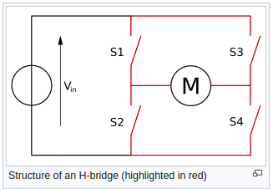
An H-bridge is an electronic circuit that switches the polarity of a voltage applied to a load. These circuits are often used in robotics and other applications to allow DC motors to run forwards or backwards

Slide 23
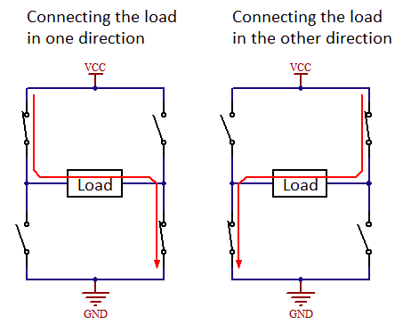

Slide 24
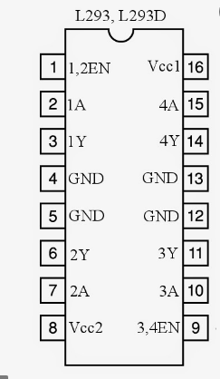
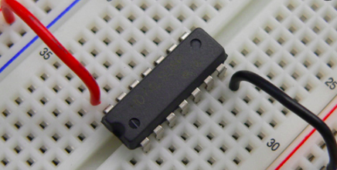
Reading IC pin out
Using IC in bread board

Slide 25
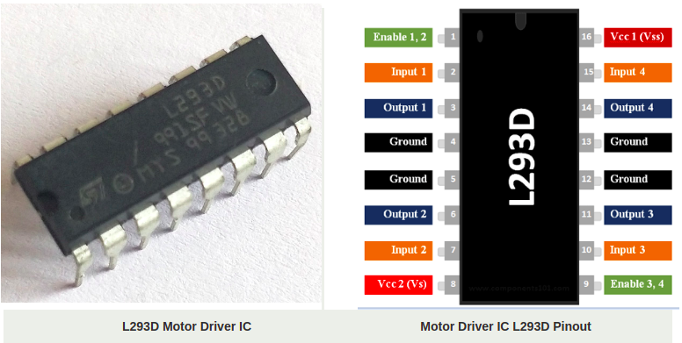

Slide 26
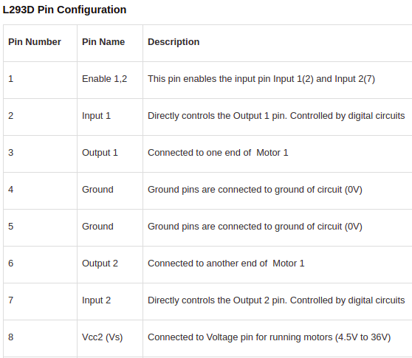
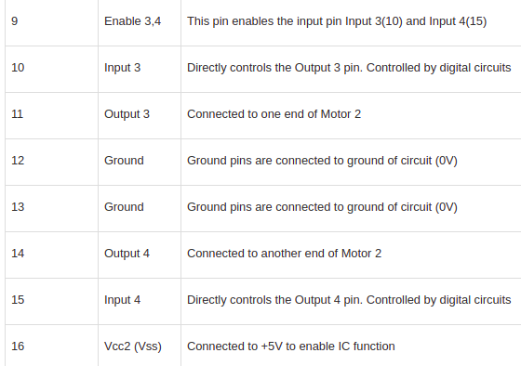

Slide 27
